Slide 1
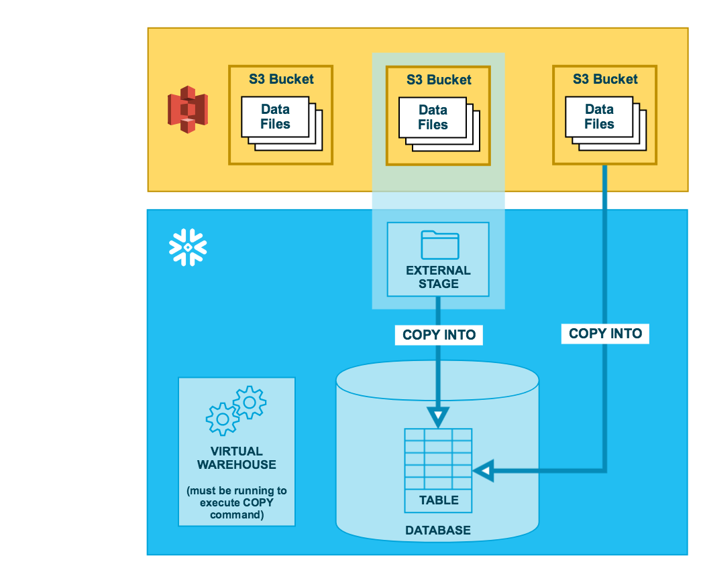
Bulk Loading From AWS S3

Slide 2
AWS S3 Stage
Accessing Amazon S3 Buckets By Creating a S3 Stage
Prerequisite → Snowflake VPC ID should be whitelisted to allow Snowflake to access the Customer’s Amazon S3 bucket securely
VPC IDs ->https://docs.snowflake.net/manuals/user-guide/admin-security-privatelink.html#step-1-contact-snowflake-and-provide-aws-vpc-account-ids
Integration With S3 can be done through Below Options
Option 1: Configuring a Snowflake Storage Integration -- Third
Option 2: Configuring an AWS IAM Role -- first
Option 3: Configuring AWS IAM User Credentials -- second

Slide 3
AWS S3 Stage Cont..
AWS Private Link
AWS Private Link is an AWS service for creating private VPC endpoints that allow direct, secure connectivity between AWS VPCs without traversing the public Internet. Because Snowflake on AWS is implemented as a VPC, PrivateLink enables creating a highly-secure network between Snowflake and your other AWS VPCs (in the same AWS region), fully protected from unauthorized external access.
Enabling AWS PrivateLink
Enabling AWS PrivateLink for your account may take up to 2 business days. When you request AWS PrivateLink to be enabled, please be sure to provide the account ID for each AWS VPC you wish to connect directly to Snowflake. Providing incorrect or incomplete information may delay the process
Step 1: Contact Snowflake and Provide AWS VPC Account IDs
When you request AWS PrivateLink to be enabled, you must provide Snowflake with a list of all your AWS VPC account IDs. An account ID consists of a 12-digit string provided by AWS.
Step 2: Snowflake Provides a VPC Endpoint Address for Your Region
Snowflake whitelists your AWS VPC account ID(s) and provides you with a region-specific VPC endpoint (i.e. VPCE) address, in the form of:
com.amazonaws.vpce.<region_id>.vpce-svc-xxxxxxxxxxxxxxxxx
Where:
<region_id> is the ID for the AWS Region where your VPCs and Snowflake account are located.
Please contact Snowflake Support to obtain your AWS VPCE.

Slide 4
AWS S3 Stage Cont..
Step 1: Create S3 Bucket / Access Permissions for the S3 Bucket
Step 2: Snowflake related AWS IAM Role creation
Step 3: Creation of Snowflake Cloud Storage Integration
Step 4: AWS IAM User for your Snowflake Account updation with Snowflake
Integration
Step 5: Granting the IAM User Permissions to Access Bucket Objects
Step 6: Creating an External Stage
Step 7: Load Data into Table

Slide 5
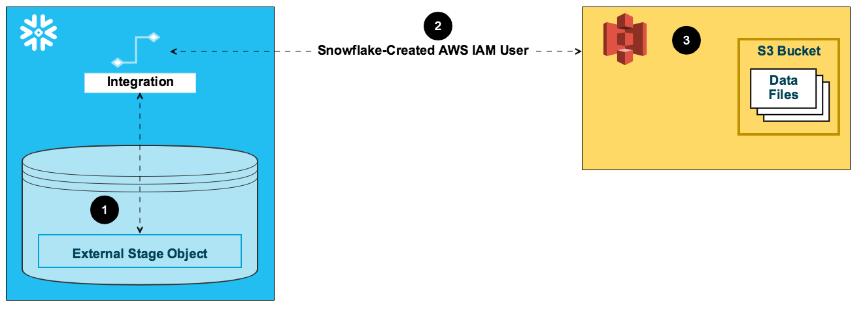
AWS S3 → Snowflake Integration

Slide 6
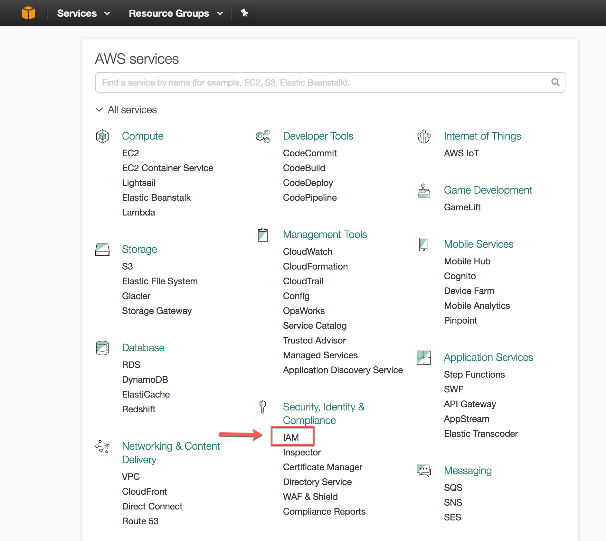
AWS IAM – Identity Access Management

Slide 7
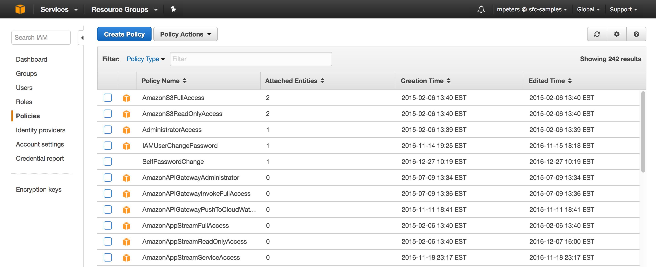
IAM Policy…

Slide 8
Policy
{
"Version": "2012-10-17",
"Statement": [
{
"Effect": "Allow",
"Action": [
"s3:PutObject",
"s3:GetObject",
"s3:GetObjectVersion",
"s3:DeleteObject",
"s3:DeleteObjectVersion"
],
"Resource": "arn:aws:s3:::snowflaketraining/*"
},
{
"Effect": "Allow",
"Action": "s3:ListBucket",
"Resource": "arn:aws:s3:::<bucket>",
"Condition": {
"StringLike": {
"s3:prefix": [
"*"
]
}
}
}
]
}

Slide 9
Snowflake Storage Integration
Create a Bucket Policy
Update the Bucket Policy with Snowflake VPC End Point Details
Bucket Policy
---------------
{
"Version": "2012-10-17",
"Id": "Policy1415115909153",
"Statement": [
{
"Sid": "Access-to-specific-VPC-only",
"Effect": "Allow",
"Principal": "*",
"Action": "s3:*",
"Resource": [
"arn:aws:s3:::sfdbbucket1",
"arn:aws:s3:::sfdbbucket1/*"
],
"Condition": {
"StringNotEquals": {
"aws:sourceVpc": "com.amazonaws.vpce.ap-southeast-1.vpce-svc-07d29a86078ceefe8"
}
}
}
]
}

Slide 10
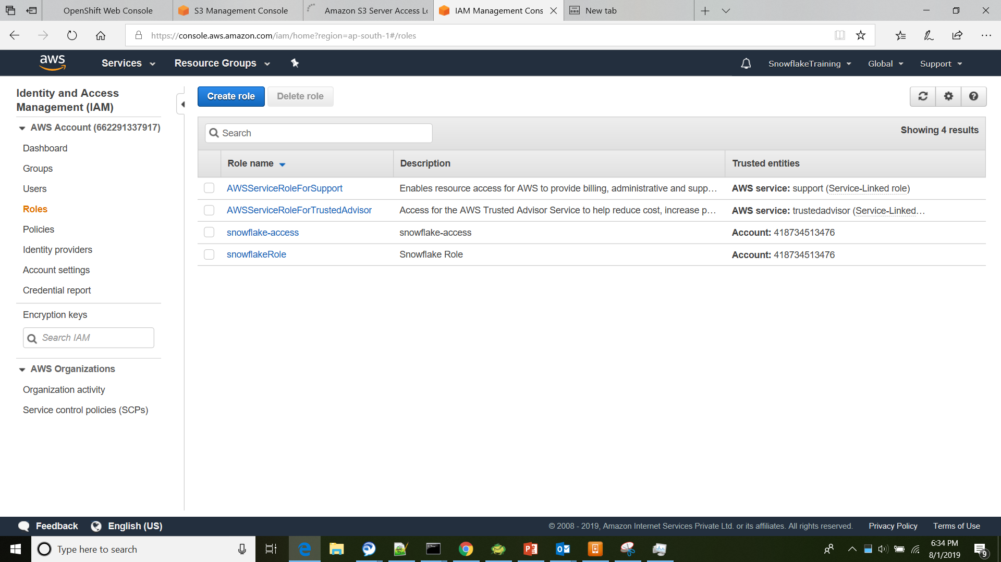
IAM Role

Slide 11
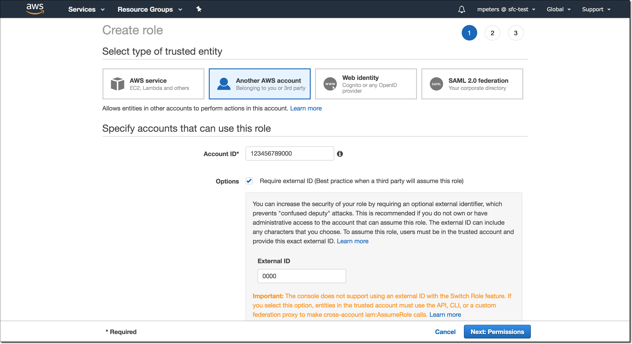
IAM Role Creation…

Slide 12
Snowflake Storage Integration
CREATE STORAGE INTEGRATION s3_snowflake_int
TYPE = EXTERNAL_STAGE
STORAGE_PROVIDER = S3
ENABLED = TRUE
STORAGE_AWS_ROLE_ARN = 'AWS Role ARN : arn:aws:iam::662291337917:role/snowflakeRole'
STORAGE_ALLOWED_LOCATIONS = ('s3://snowflaketraining/’);
desc storage integration s3_snowflake_int;

Slide 13
AWS S3 – External Stage Creation
create stage my_s3_stage
storage_integration = s3_snowflake_int
url = 's3://snowflaketraining/’
file_format = my_csv_format;
create or replace stage my_s3_stage
url='s3://snowflaketraining/labmaterial/’
credentials = (aws_role = 'arn:aws:iam::662291337917:role/snowflake-access’)
encryption=(type='aws_sse_kms' kms_key_id = 'aws/key');

Slide 14
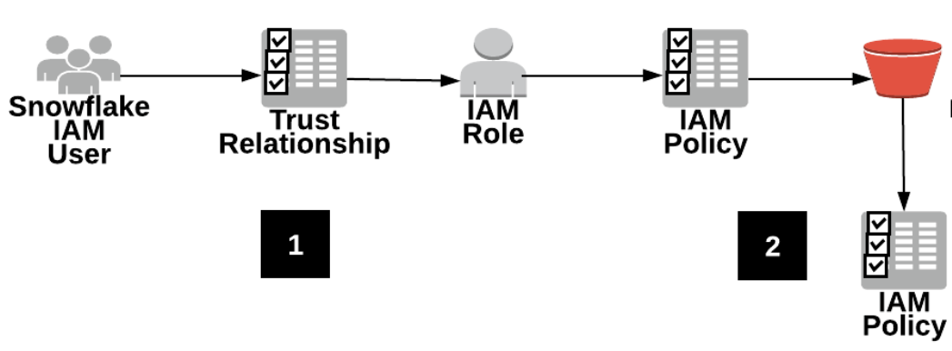
AWS S3 Stage – By IAM Role
Configuring an AWS IAM Role
An AWS IAM user created for your Snowflake account is associated with an IAM role you configure via a trust relationship.
The role is granted limited access to an S3 bucket through IAM policies you configure
Step 1: Configure S3 Bucket Access Permissions
AWS Access Control Requirements
Snowflake requires the following permissions on an S3 bucket and folder to be able to access files in the folder (and any sub-folders):
s3:GetObject
s3:GetObjectVersion
s3:ListBucket
Creating An IAM Policy

Slide 15
AWS S3 Stage – By IAM Role
Configuring an AWS IAM Role
Log into the AWS Management Console.
From the home dashboard, choose Identity & Access Management (IAM):
Choose Account settings from the left-hand navigation pane.
Expand the Security Token Service Regions list, find the AWS region corresponding to the region where your account is located, and choose Activate if the status is Inactive.
Choose Policies from the left-hand navigation pane.
Click Create Policy:
Click the JSON tab.
Add a policy document that will allow Snowflake to access the S3 bucket and folder.
{
"Version": "2012-10-17",
"Statement": [
{
"Effect": "Allow",
"Action": [
"s3:PutObject",
"s3:GetObject",
"s3:GetObjectVersion",
"s3:DeleteObject",
"s3:DeleteObjectVersion"
],
"Resource": "arn:aws:s3:::<bucket>/<prefix>/*"
},
{
"Effect": "Allow",
"Action": "s3:ListBucket",
"Resource": "arn:aws:s3:::<bucket>",
"Condition": {
"StringLike": {
"s3:prefix": [
"<prefix>/*"
]
}
}
}
]
}

Slide 16
AWS S3 Stage – By IAM Role
Configuring an AWS IAM Role
Click Review policy.
Enter the policy name (e.g. snowflake_access) and an optional description. Then, click Create policy to create the policy.
Create an AWS IAM Role
Log into the AWS Management Console.
From the home dashboard, choose Identity & Access Management (IAM):
Choose Roles from the left-hand navigation pane.
Click the Create role button.
Select Another AWS account as the trusted entity type.
In the Account ID field, enter your own AWS account ID. Later, you will modify the trusted relationship and grant access to Snowflake. An external ID is required to grant access to your AWS resources (i.e. S3) to a third party (i.e. Snowflake in this case) later in these instructions.
Select the Require external ID option. Enter a dummy ID such as 0000. Later, you will modify the trusted relationship and specify the external ID for your Snowflake stage.
Click the Next button.
Locate the policy you created in earlier, and select this policy.
Click the Next button.
Enter a name and description for the role, and click the Create role button.
You have now created an IAM policy for a bucket, created an IAM role, and attached the policy to the role.
Record the Role ARN value located on the role summary page. In the next step, you will create a Snowflake stage that references this role as the security credentials.

Slide 17
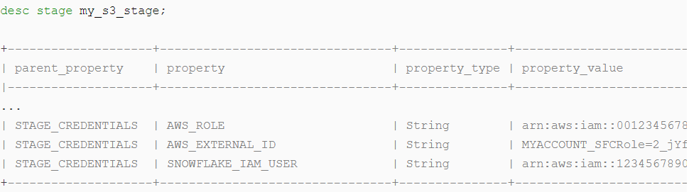
AWS S3 Stage – By IAM Role
Create an External Stage
Create an external (i.e S3) stage that references the AWS role you created.
Create an external stage using the CREATE STAGE command, or you can choose to alter an existing external stage and set the CREDENTIALS option.
create stage my_s3_stage url='s3://sftrngbucket' credentials = (aws_role = 'arn:aws:iam::001234567890:role/mysnowflakerole') encryption=(type='AWS_SSE_KMS' kms_key_id = 'aws/key’);
Save the values for the SNOWFLAKE_IAM_USER and AWS_EXTERNAL_ID properties
SNOWFLAKE_IAM_USER
An AWS IAM user created for your Snowflake account. This user is the same for every external S3 stage created in your account.
AWS_EXTERNAL_ID
A unique ID assigned to the specific stage. The ID has the following format

Slide 18
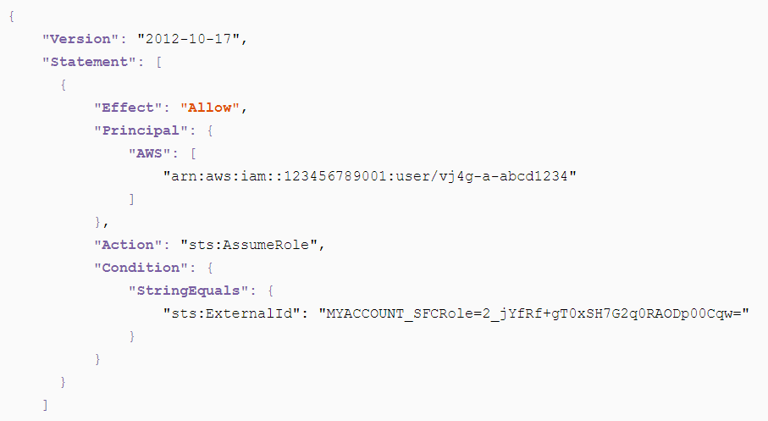
AWS S3 Stage – By IAM Role
Configure the AWS IAM Role to Allow Access to the Stage
Log into the AWS Management Console.
From the home dashboard, choose Identity & Access Management (IAM)
Choose Roles from the left-hand navigation pane, and click on the role you
Click the Trust relationships tab, and click the Edit trust relationship button.
In the Policy Document field, update the policy with the property values for the stage:
AWS: Enter the ARN for the SNOWFLAKE_IAM_USER stage property, arn:aws:iam::123456789001:user/vj4g-a-abcd1234 in this example.
sts:ExternalId: Enter the generated external ID, i.e. MYACCOUNT_SFCRole=2_jYfRf+gT0xSH7G2q0RAODp00Cqw= in this example.
Click the Update Trust Policy button.
List the Stage and look for the files Loaded onto your S3 Buckets

Slide 19
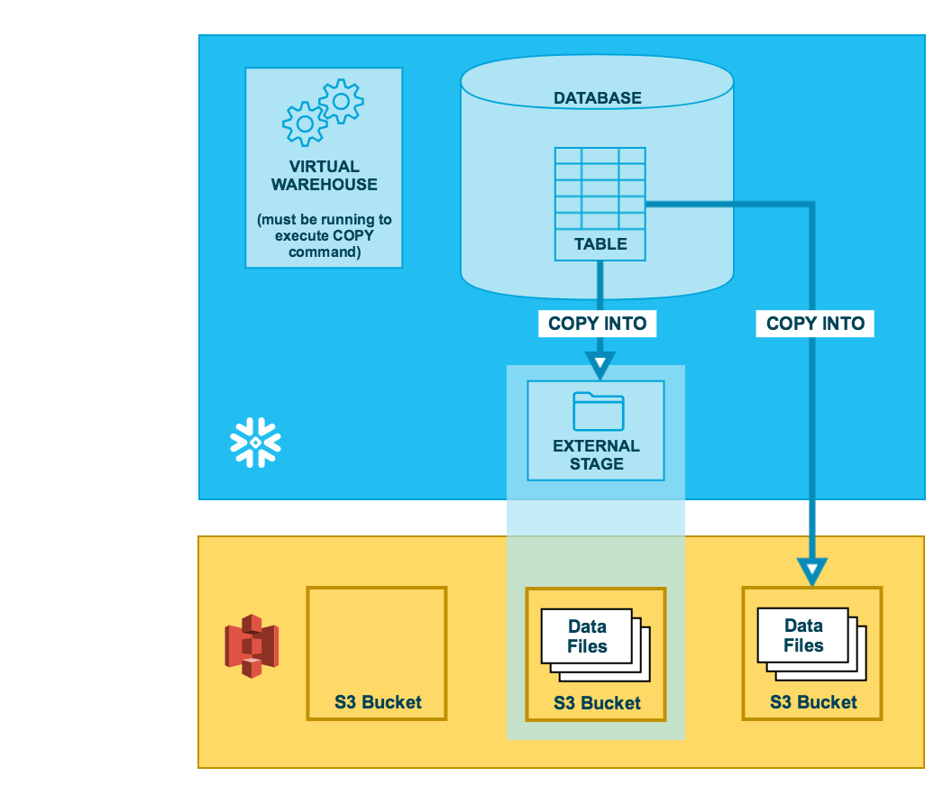
Unloading on to AWS S3

Slide 20
Data Unloading / Export
Unloading Table into External Stage – AWS
copy into s3://sfdbbucket1 from MY_CUSTOMER storage_integration=s3_snowflake_int file_format = (format_name = 'my_csv_format’);
Generating Single / Multiple Files BY Max_file_size
copy into @~ from my_customer single = true;
copy into @~ from my_customer single = false;
Validating Unloading Data
copy into @my_temp_stage from (select * from my_customers limit 5) validation_mode='RETURN_ROWS';

